Slide 1
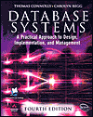
Lecture One
Introduction to Databases
Reference Book:
Database Systems: A Practical Approach to Design, Implementation and Management
International Computer Sciences.
Carolyn Begg, Thomas Connolly

Slide 2
Lecture 1: Objectives
Some common uses of database systems.
Characteristics of file-based systems.
Problems with file-based approach.
Meaning of the term database.
Meaning of the term Database Management System (DBMS).

Slide 3
Lecture 1: Objectives
Typical functions of a DBMS.
Major components of the DBMS environment.
Personnel involved in the DBMS environment.
History of the development of DBMSs.
Advantages and disadvantages of DBMSs.

Slide 4
Examples of Database Applications
Purchases from the supermarket
Purchases using your credit card
Booking a holiday at the travel agents
Using the local library
Taking out insurance
Using the Internet
Studying at university

Slide 5
Quiz:
Identify four further examples of database systems

Slide 6
File-based Systems
Collection of application programs that perform services for the end users (e.g. reports).
Each program defines and manages its own data.

Slide 7
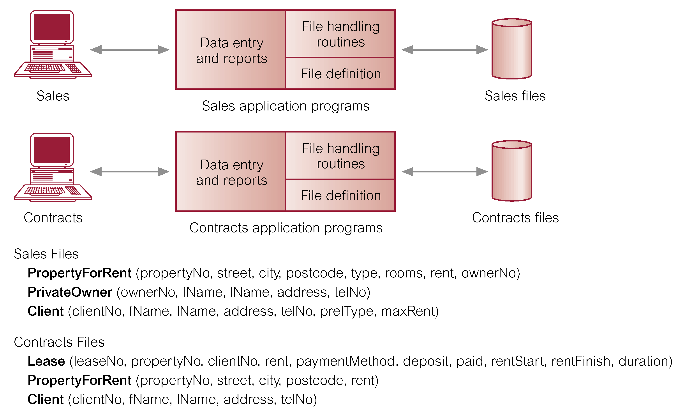
File-based Processing

Slide 8
Limitations of File-based Approach
Separation and isolation of data
  Each program maintains its own set of data.
  Users of one program may be unaware of potentially useful data held by other programs.
Duplication of data
  Same data is held by different programs.
  Wasted space and potentially different values and/or different formats for the same item.

Slide 9
Limitations of File-based Approach
Data dependence
  File structure is defined in the program code.
  So File depends on the application program through which the file was created.
Incompatible file formats
  Programs are written in different languages, and so cannot easily access each others files.
Fixed Queries/Proliferation of application programs
  Programs are written to satisfy particular functions. Any new requirement needs a new program.

Slide 10
Quiz?:
Describe the approach taken to the
handling of data in the early file-based
systems. Discuss the disadvantages of
this approach.

Slide 11
Possible Solution to Quiz?
Focus was on applications for which programs would be written, and all the data required would be stored in a file or files owned by the programs.
Clearly, each program was responsible for only its own data, which could be repeated in other program’s data files. Different programs could be written in different languages, and would not be able to access another program’s files. This would be true even for those programs written in the same language, because a program needs to know the file structure before it can access it.

Slide 12
Database Approach:
Arose because:
  Definition of data was embedded in application programs, rather than being stored separately and independently.
  No control over access and manipulation of data beyond that imposed by application programs.
Result
  the database and Database Management System (DBMS).

Slide 13
Database
Shared collection of logically related data (and a description of this data), designed to meet the information needs of an organization.
System catalog (metadata) provides description of data to enable program–data independence.
Logically related data comprises entities, attributes, and relationships of an organization's information.

Slide 14
Database Management System (DBMS)
A software system that enables users to define, create, and maintain the database and which provides controlled access to this database.

Slide 15
Quiz?
Describe the main characteristics
of the database approach and
contrast it with the file-based
approach.

Slide 16
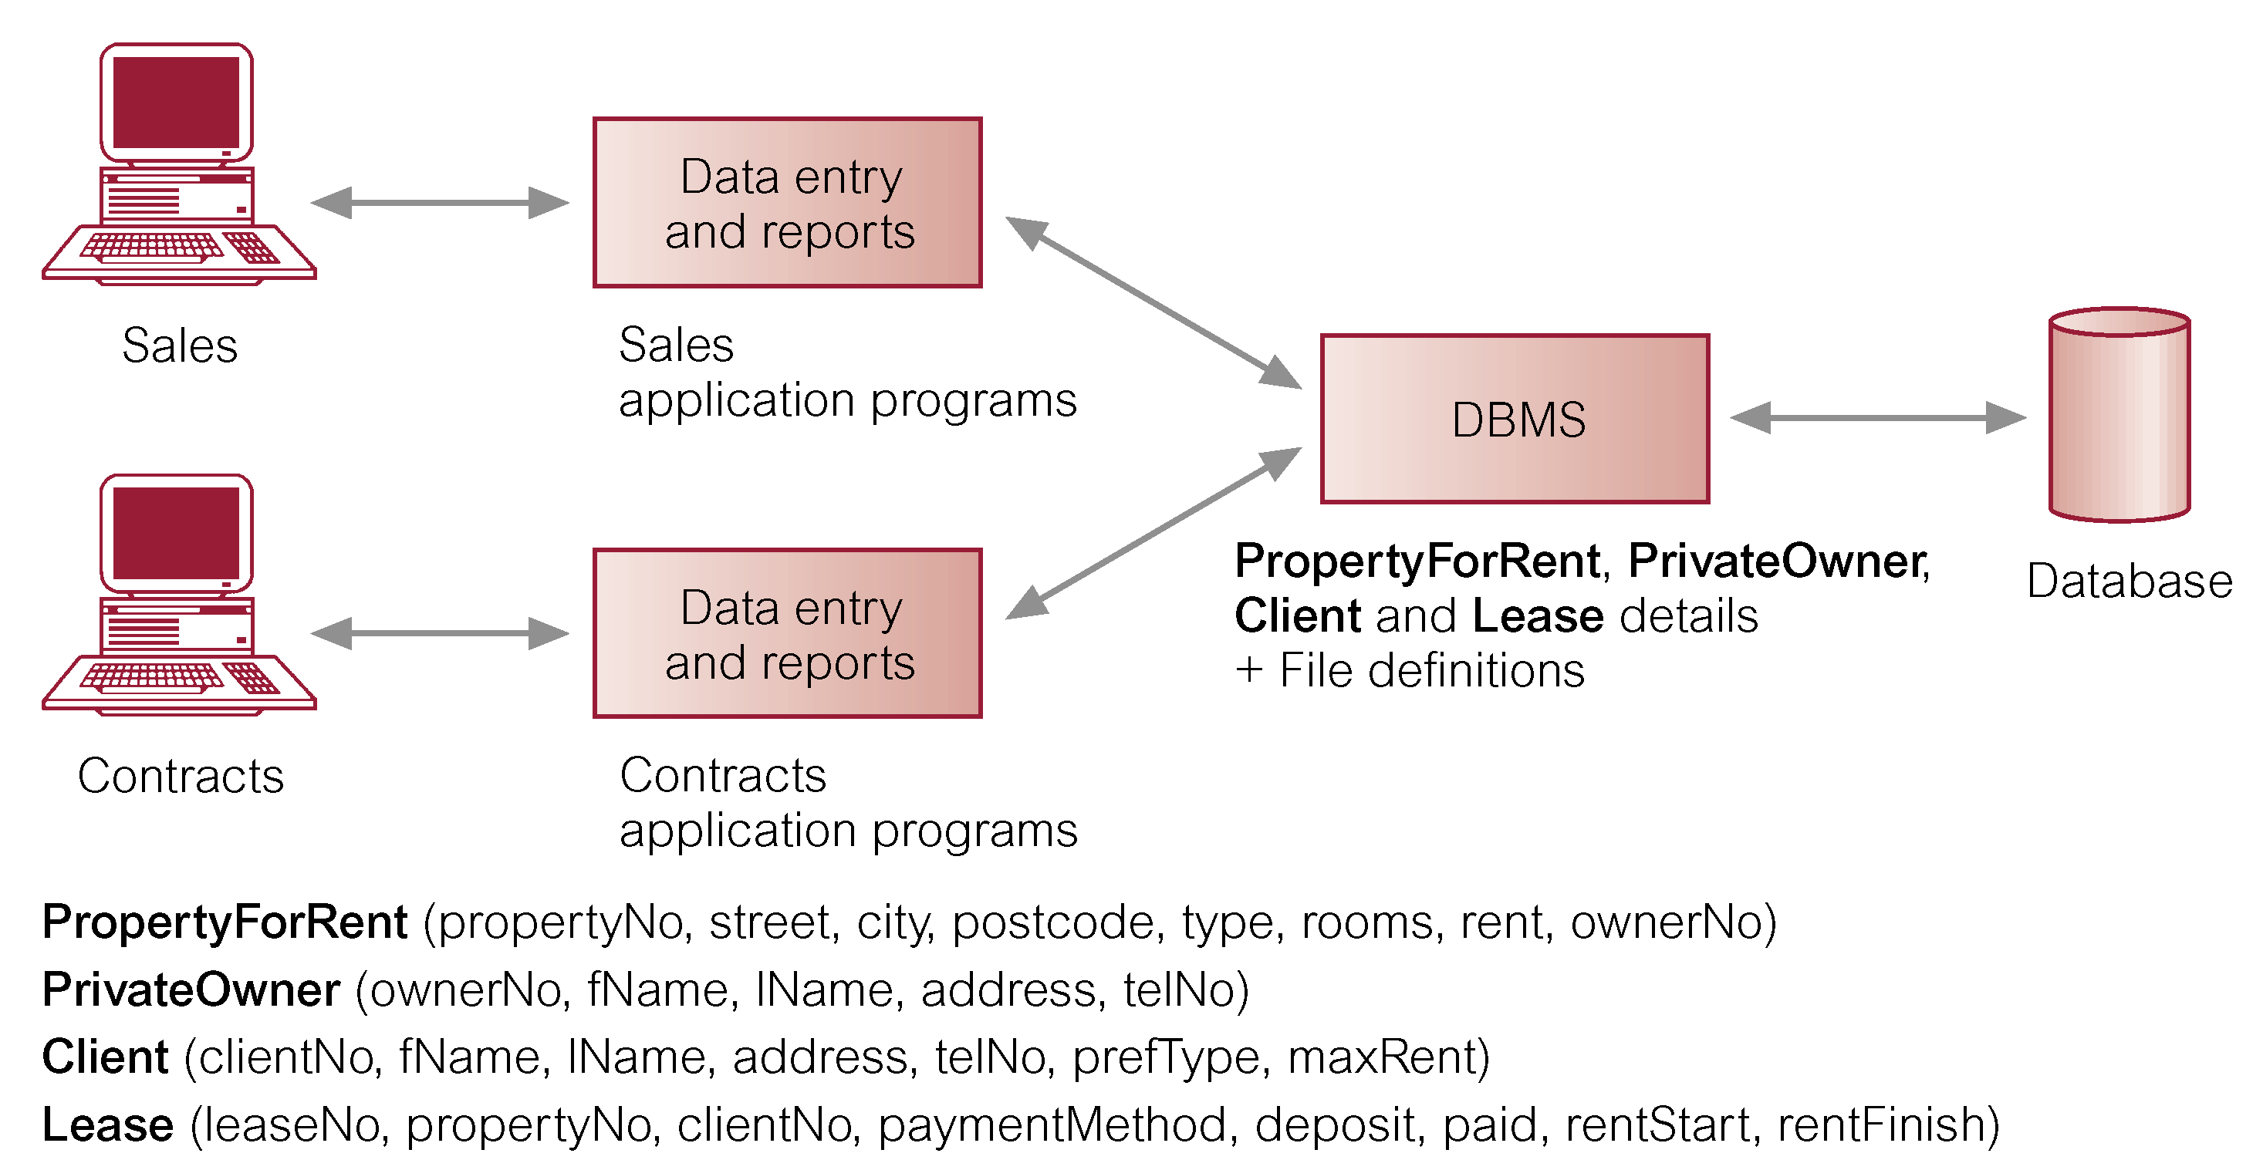
Database Management System (DBMS)

Slide 17
Database Approach
Data definition language (DDL).
  Permits specification of data types, structures and any data constraints.
  All specifications are stored in the database.
Data manipulation language (DML).
  General enquiry facility (query language) of the data.
Notes:
Constraints are used to limit the type of data that can go into a table. This ensures the accuracy and reliability of the data in the table.

Slide 18
Database Approach
Controlled access to database may include:
  A security system.
  An integrity system.
  A concurrency control system.
  A recovery control system.
  A user-accessible catalog.
A view mechanism.
  Provides users with only the data they want or need to use.
Notes:
Concurrency Control in DBMS is a procedure of managing simultaneous transactions ensuring their atomicity, isolation, consistency, and serializability.

Slide 19
Views
Allows each user to have his or her own view of the database.
A view is essentially some subset of the database.

Slide 20
Views
Benefits include:
  Reduce complexity;
  Provide a level of security;
  Provide a mechanism to customize the appearance of the database;
  Present a consistent, unchanging picture of the structure of the database, even if the underlying database is changed.

Slide 21
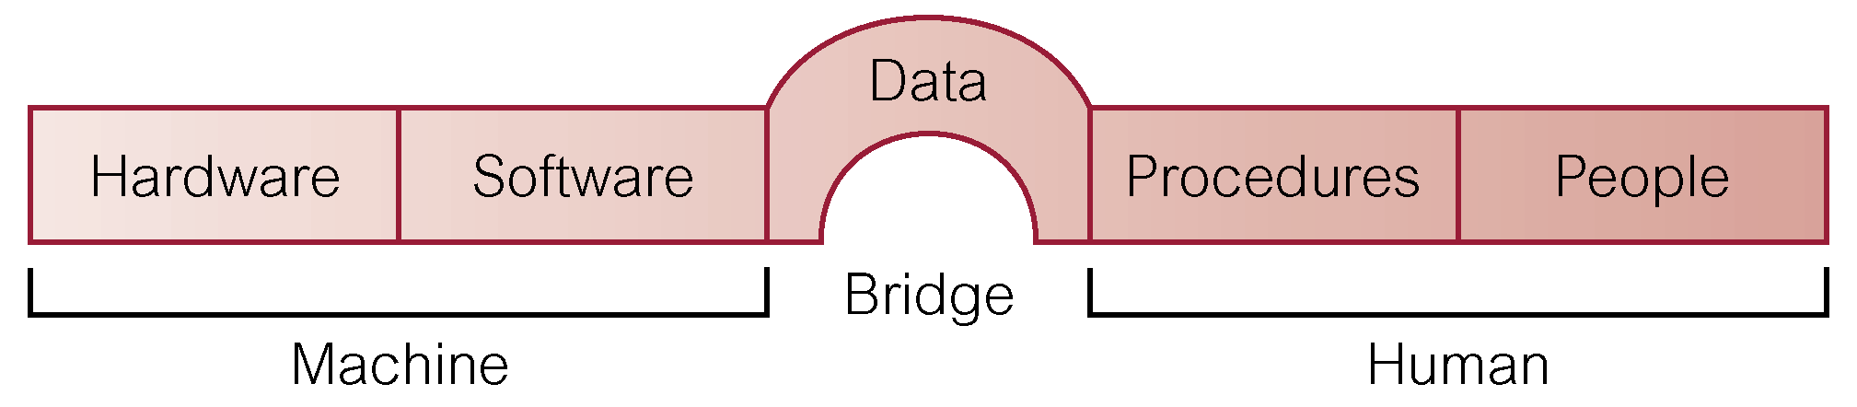
Components of DBMS Environment

Slide 22
Components of DBMS Environment
Hardware
  Can range from a PC to a network of computers.
Software
  DBMS, operating system, network software (if necessary) and also the application programs.
Data
  Used by the organization and a description of this data called the schema.
Notes:
A database schema defines how data is organized within a relational database; this is inclusive of logical constraints such as, table names, fields, data types, and the relationships between these entities.

Slide 23
Components of DBMS Environment
Procedures
  Instructions and rules that should be applied to the design and use of the database and DBMS.
People

Slide 24
Roles in the Database Environment
Data Administrator (DA)
Database Administrator (DBA)
Database Designers (Logical and Physical)
Application Programmers
End Users (naive and sophisticated)

Slide 25
Quiz:
1. Discuss the roles of the following personnel in the
database environment:
Data Administrator (DA)
Database Administrator (DBA)
Database Designers (Logical and Physical)
Application Programmers
End Users (naive and sophisticated)
2. History of Database Management Systems
3. Advantages and Disadvantages of DBMS

